Slide 1
Skidaway Hamiltons 2018-2019

Slide 2
Welcome to new Skidaway Hamilton Board members

Slide 3
Welcome to new board member
Rick Cunningham

Slide 4
Welcome to new board member
Marty Grossman and new Hamilton’s treasurer

Slide 5
Thank you to retiring board members: Both founding members of the Hamilton’s

Slide 6
JP Blachere –
Instrumental in writing the Hamilton’s mission and value statements

Slide 7
Stu Weiner –
Treasurer since our inception

Slide 8
Brief review of the year’s speakers

Slide 9
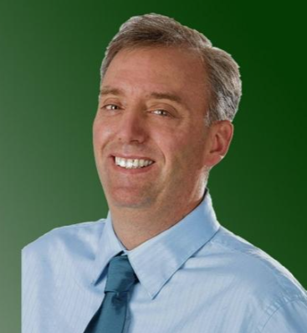
September: Adam Van Bremmer, Opinion page editor of the Savannah Morning News

Slide 10
Oct.: Professor and director of the Skidaway Institute of Oceanography, Clark Alexander, spoke on climate change

Slide 11
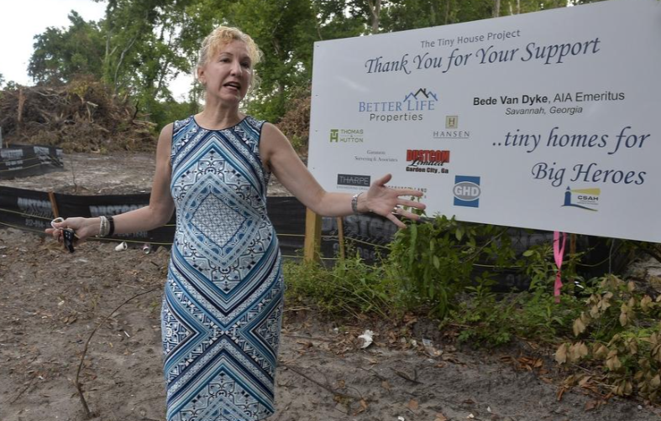
Nov.: Cindy Kelly, Executive Director of the Chatham Savannah Authority for the Homeless, spoke on the tiny houses project for the veterans.

Slide 12
Dec.: Dr. Ken Zapp’s presentation on the role of government in a market capitalist economy

Slide 13
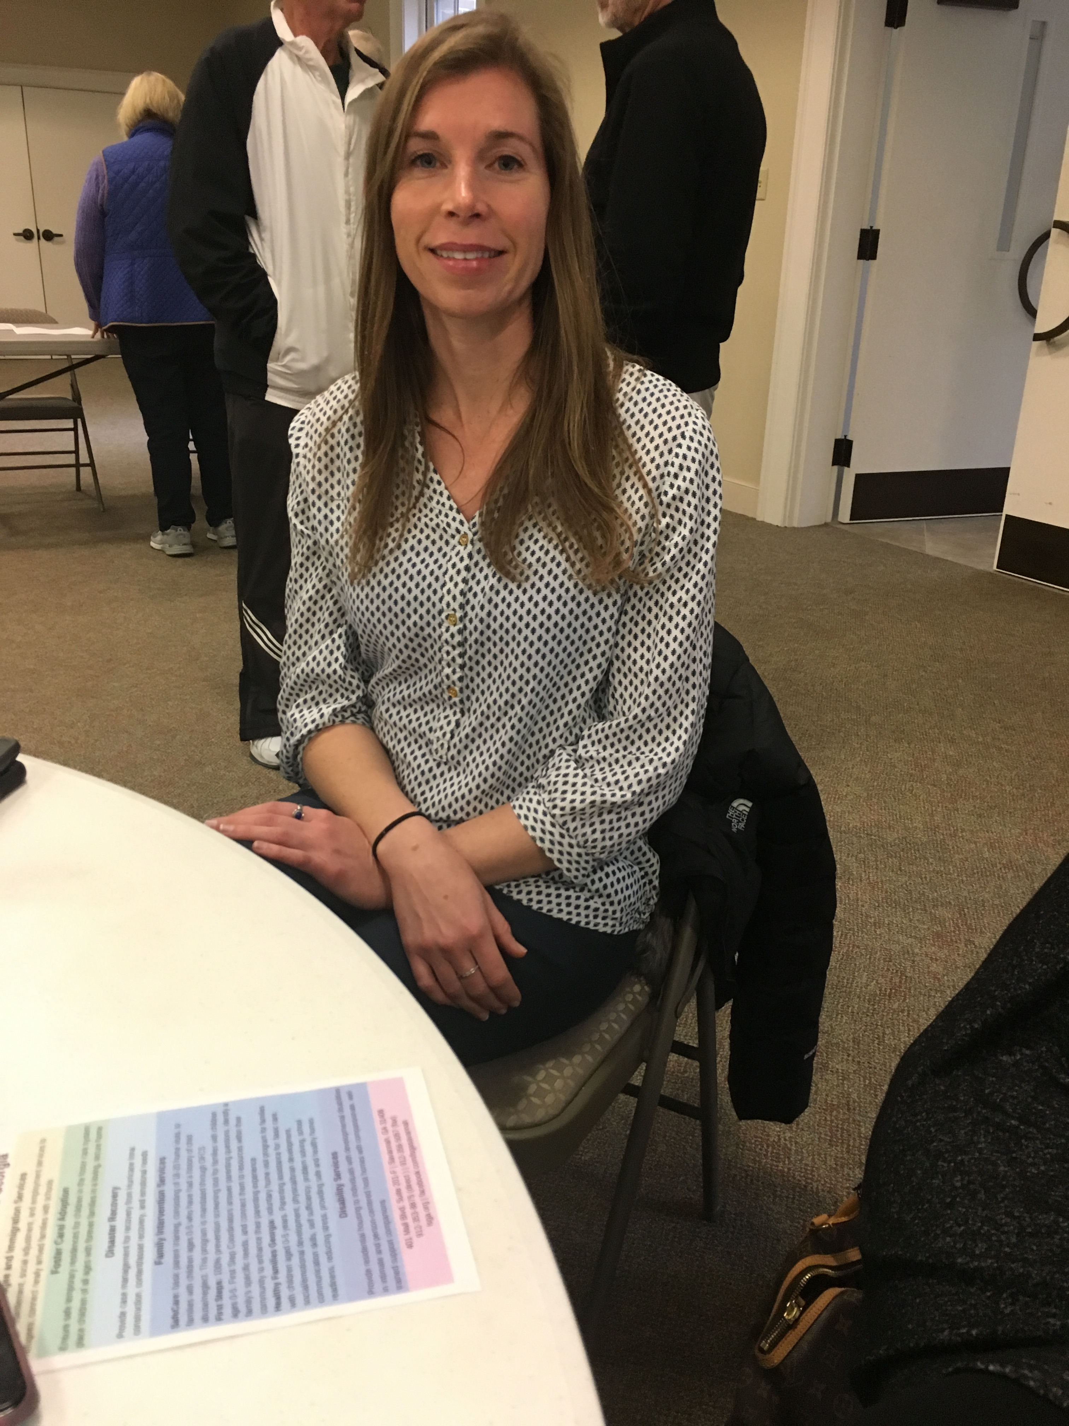
Jan.: Angel Sorochak, Regional Director-Coastal Region of Lutheran Services of Georgia, and Lauren Cruikshank, Program Manager of Refugee Services and Disaster Response

Slide 14
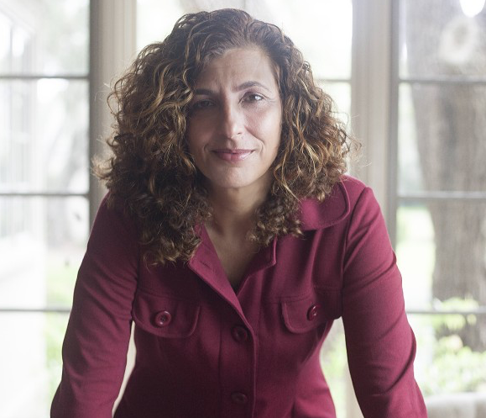
Feb.: Lisa Ring, recent 2016 Democratic Party Candidate for Congress in the 1st district of Georgia

Slide 15
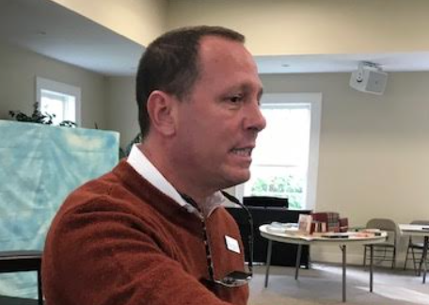
March: Al Holzinger—Volunteer for the United Way and Jamey Espina from Hospice Savannah

Slide 16
April: Bill Broker, Managing Lawyer of the Savannah Regional Office of Georgia Legal Services

Slide 17
Sept., 2019 speaker will discuss “Gerrymandering”

Slide 18
Brews and Views

Slide 19
Topics discussed in Brew and Views

Slide 20
Topics discussed in Brew and Views
Financial inequality in America

Slide 21
Topics discussed in Brew and Views
Financial inequality in America
Gun Control

Slide 22
Topics discussed in Brew and Views
Financial inequality in America
Gun Control
Homelessness

Slide 23
Topics discussed in Brew and Views
Financial inequality in America
Gun Control
Homelessness
Costal Drilling and Congressman’s Buddy Carter’s position

Slide 24
Topics discussed in Brew and Views
Financial inequality in America
Gun Control
Homelessness
Costal Drilling and Congressman’s Buddy Carter’s position
The state of the prison industry in the U.S.

Slide 25
What’s coming up next year?

Slide 26
The Skidaway Hamilton co-presidents for 2019-2020

Slide 27
Hamilton co-president
Tom Hamilton

Slide 28
Hamilton co-president
Bob Marcotullio

Slide 29
Before we go further I have one more announcement:

Slide 30
The passing of the Hamilton’s Key (Church key)
This Photo by Unknown Author is licensed under CC BY-NC

Slide 31
So what is the future direction of Skidaway Hamiltons

Slide 32
We need your input

Slide 33
Topics you would like to hear from speakers
Topics discussed in Brew and Views

