Slide 1
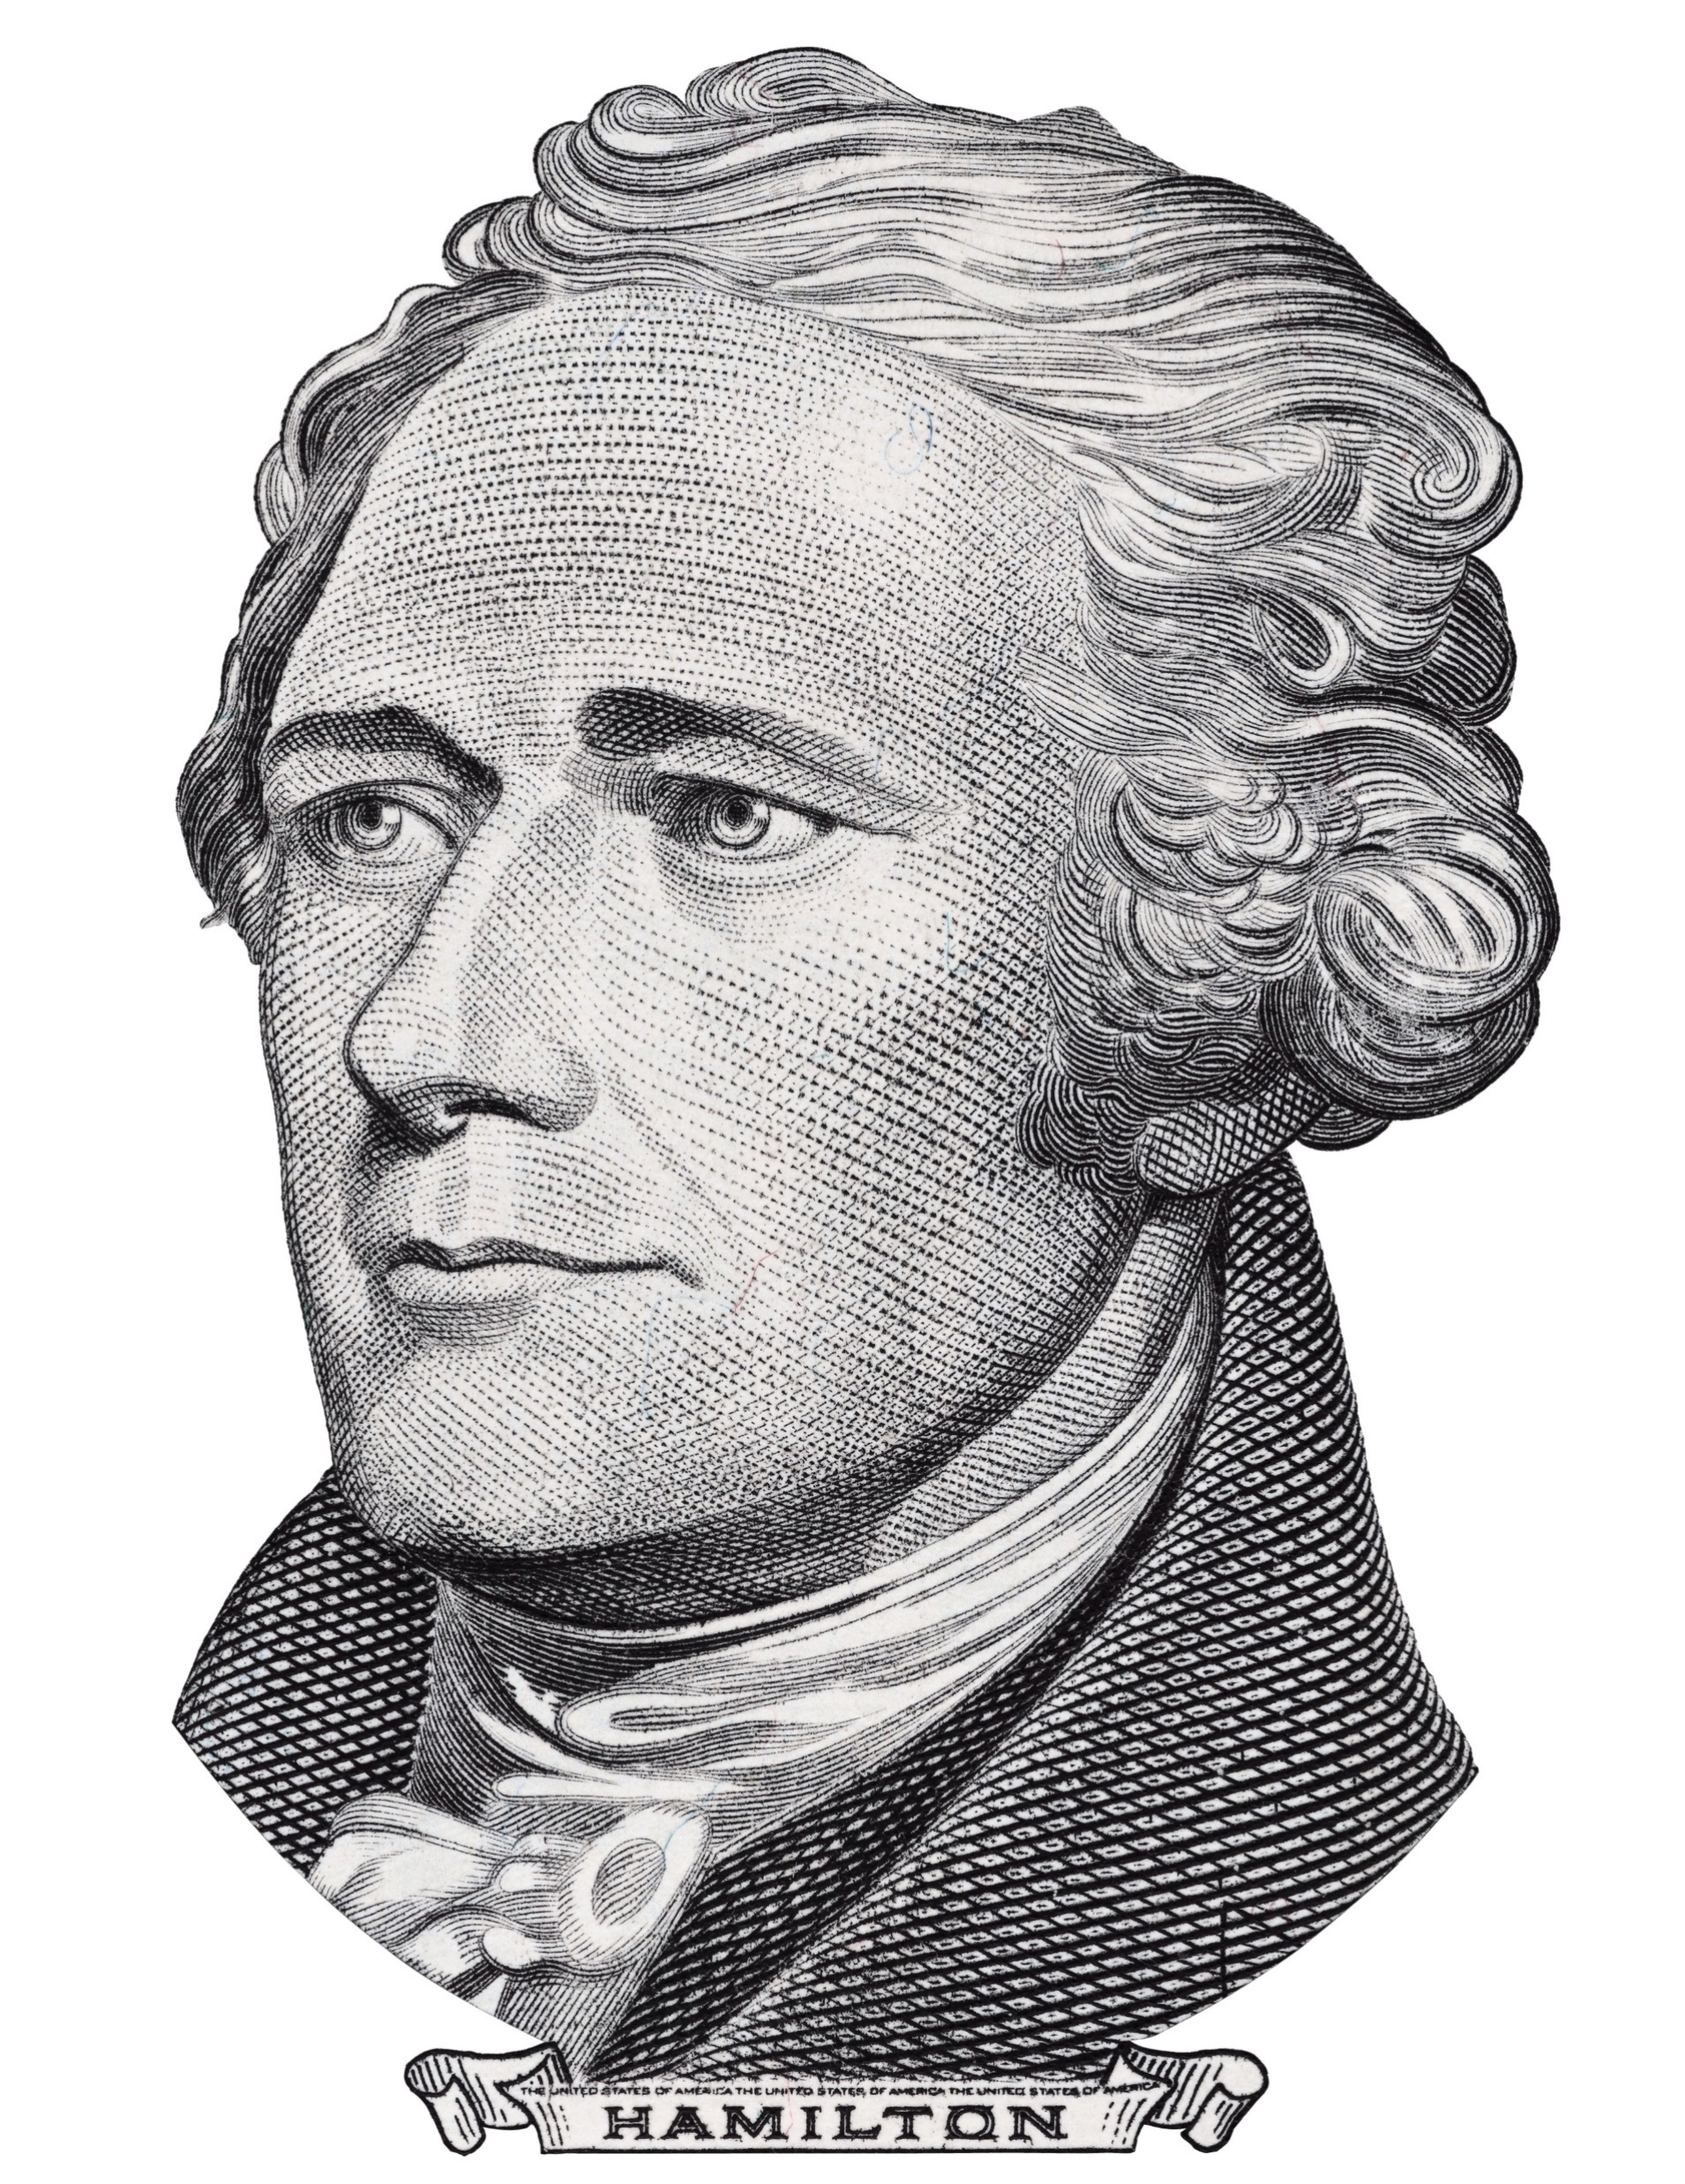
Hamiltons at a Year
4/17/2018
This Photo by Unknown Author is licensed under CC BY-SA

Slide 2
In the Beginning
About January 2017 – about 10 men met to discuss forming a Liberal, Progressive men’s group
For the next 3 months, a small steering group worked to develop a Structure, Mission and Values for the Hamiltons
First general meeting March 21st 2017
About 80 attendees

Slide 3
Structure From 2017 Meeting
Non-partisan
We will not support parties or candidates
We will not allow fund raising or solicitation of members
Three Goals
Social, Education, Advocacy
Controlled membership & email list
For independent men who wish to expand knowledge
Not restricted to Landings residents
Small dues to cover space rental - $15/year (currently $20)
Planned to have 2-4 speakers and/or social events the first year

Slide 4
Mission
The Hamiltons is an organization of liberal, progressive men whose purpose is to provide an environment for comfortable social engagement, a forum for discussion of sociopolitical issues, and a framework to champion our values. We welcome men who support our values to join us, regardless of residence, race, ethnicity, age, religion, political affiliation, or sexual orientation.

Slide 5
Hamiltons’ Values
WE VALUE:
A society and government that diligently pursues fairness, justice and equality for all
A national health care system that makes medical services available to all regardless of preconditions and economic status.
A tax system and laws that reduce economic inequality and offset the power of corporations and money in influencing government.
And support women’s efforts to achieve fair and equitable opportunities and to control their reproductive rights.
Quality public education, from preschool through college, available and affordable to all residents of the United States.

Slide 6
Hamiltons’ Values
WE VALUE:
Government financial support to Science and Technology, Arts and Humanities
A fair, unbiased criminal justice system and penal institutions that focuses upon rehabilitation and humane treatment.
An emphasis on diplomatic and “soft power” in world affairs.
Government policies that protect the environment.
We believe that the American citizen’s right to vote should not be infringed upon in any fashion.
We believe that freedom of the press and freedom of speech are the foundations of a free and democratic society.

Slide 7
So What Have We Done?
Social:
Initial Meeting (3/21/2017)
Summer Social at Delegal Marina
4 Brews and Views at members homes
Educational – Hamiltons Meeting
Mark Streeter (5/2017) – Savannah Morning News
Daniel Kelin (10/2017) - Counterterrorism
Lloyd Johnson (11/2017) – Savannah 100
Dr. Butch Pally (12/2017) – Chatham Health Care
Ms. Rebecca Rolfes (1/2018) – The New Journalism
Attorneys Claiborne & Utter (2/2018) – Social media and Civil Rights
Reedsville Panel (3/2018) – Report on Prison Tour

Slide 8
So What Have We Done?
Educational – Invited by WAGS
Ed & Margarite Baxter (5/2017) – Lobbying 101
Tom Barton (6/2017) – Savannah Morning News
Lester Jackson (8/2017) – Progress at the State House
Ronald Christopher (11/2017) – Renaming the Talmadge Bridge
Common Cause (1/2018) - Gerrymandering
Georgia WINS (2/2018) – Supporting Woman for Georgia Office
Moms Demand Action (3/2018) – Gun Saftey Reform

Slide 9
So What Have We Done?
Advocacy – Education and Coordination
ACLU School – (4/2017)
Formation of Hamiltons Advocacy groups (5/2017)
Educational Health Forum (WAGS) (5/2017)
ACLU/Common Cause Gerrymandering (11/2017)
Step Up Savannah (2/2018)
Tour of Reedsville Prison (3/2018)
Health Advocacy Training (SUS) (4/2018)

Slide 10
So What Have We Done?
Advocacy – Protests and Rallies
Planned Parenthood (2/2017)
Buddy Carter Town Hall (2/2017)
Letter writing about Talmadge Bridge (2/8, 2/13)
Buddy Carter Town Hall (2/2018)
Lobby Days Atlanta (2/2018), (3/2018 - canceled)
Support Student Walkout (3/14/2018)
March for our Lives (3/24/2018)

Slide 11
So What Have We Done?
Communication
Web-site www.SkidawayHamiltons.org
Not up to date
Email Communication
175 on email list
Seven Monthly News Letters
36 General Announcements
15 Advocacy Announcements

Slide 12
Summary
Overachieved
Six Meetings with speakers
30 – 40 attendees/meeting
Invited to Seven WAGS meetings with speakers
Organized Five Social events
Established One ongoing Advocacy Group (Prison Reform & Gun Control)
Attended Seven Advocacy Education Events
Supported Nine Protests

Slide 13
Steering Group
Ted Yachik (Chair)
Jean-Paul Blachere
Zeddie Bowen
Tom Cornwell (Moved)
Robert Pawlicki
Bruce Wallace
Stuart Weiner (Treasurer)
Ron Krannich
Jim Waterman

Slide 14
Where Do You Want to Go? Are We On the Right Track?
Social
What? How often?
Educational
Speakers? Activities? Information pushed by email?
Advocacy
Passionate about an issue? , Action Alerts?
Volunteerism
Interested in knowing about activities?
What Can You Do?

